Slide 1

Telecom Churn Analysis
p.sameera

Slide 2

PROBLEM STATEMENT
his project helps a telecom company find out which customers are likely to stop using their service a problem known as customer churn. By using customer data like how long they've been with the company, their monthly charges, contract type, and internet usage, we can build a machine learning model to predict who might leave. This lets the company act early offering better deals or support to keep customers and avoid losing money.

Slide 3
Project Description
In this project, I built a machine learning model to predict customer churn for a telecom company. The goal was to find out which customers are likely to leave the service so the company can take action to keep them. I used customer data like contract type, monthly charges, and tenure. After cleaning and processing the data, I trained a Logistic Regression model. The model was evaluated using accuracy, precision, recall, and F1-score. Key factors like short tenure, high charges, and month-to-month contracts were found to increase the chance of churn. This helps the company improve customer retention and reduce losses.

Slide 4

WHO ARE THE END USERS?
Company Executives: Use the results to make smart business decisions.
Marketing Teams: Create offers to keep customers happy.
Customer Service Managers: Find unhappy customers and reach out before they leave.
Data Analysts & BI Teams: Monitor the model and keep improving it.
Product Teams: Improve services based on customer preferences.
Loyalty & CRM Teams: Use predictions to design personalized loyalty programs

Slide 5

Technology Used
Language: Python
Libraries:Data Handling: Pandas, NumPy
Visualization: Matplotlib, Seaborn, MissingnoModeling: Scikit-learn (Logistic Regression, Evaluation Metrics)
Preprocessing: StandardScaler, Label Encoding
Model Tuning: GridSearchCV
Tools: Google Colab

Slide 6
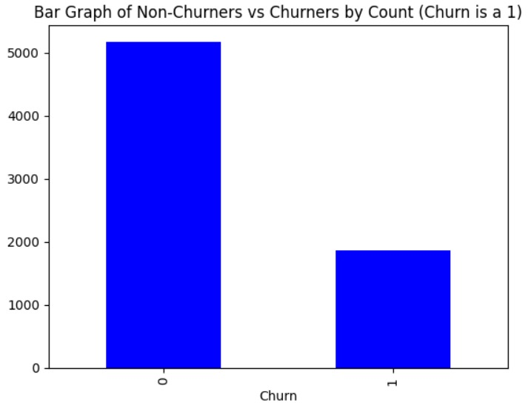
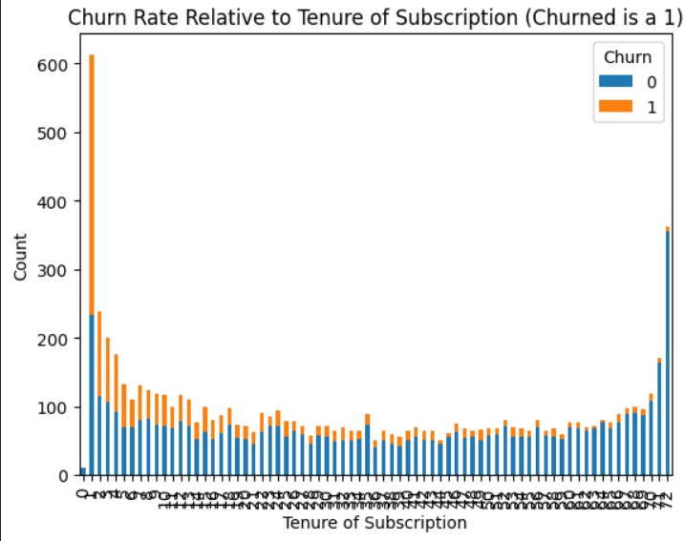
RESULTS
Demo Link

Slide 7
Thank you
.
.

